Slide 1
Entertainer Data Analysis

Slide 2
Content
Introduction
Task
Data Preparation
Provided Data
Data added to the current Dataset
Tools
Theme
Visuals

Slide 3
Introduction
Normal life can be stressful, and people need to relax. Being entertained by others is a wonderful way to take some time out of life.
It can reduce stress and make life's issues easier to face.
The media and entertainment industry consists of film,television, radio and print.
These segments include movies, TV shows, radio shows, news, music, newspapers, magazines, and books.
Entertainment industry is a group of sub-industries devoted to entertainment.
Entertainment industry is used to describe the mass media companies that control the distribution and manufacture of mass media entertainment.

Slide 4
Introduction Cont.d
Let’s enjoy weekend by having some binge watch!!! Hola Data Analysts, find me out the best shows for my weekend.
Technology is making entertainment a more data-oriented experience.
Content creators can leverage the data to generate new practices and innovative opportunities to create better quality content and create new material for consumers.
New technologies like smartphones and digital media allow consumers to connect to a new entertainment world enabled by these disruptive technologies

Slide 5
Task
In a word document write the process and data added to the current dataset. In addition, mention the theme on which you will be creating the dashboard.
You can add your data as per your convenience.
Do the data preparation part.
Build the dashboards
Build a Storyline

Slide 6
Data Preparation
Data was given into three parts: (1) Entertainer— Basic Info, (2)Entertainer — Breakthrough Info and (3) Entertainer — Last work Info.
I combined them into a single file named "Entertainer Data Analysis".
We have added data from our part for getting more insight.
Source: https://www.imdb.com/

Slide 7
Provided Data
Column Name | Description
Entertainer | containing name of Entertainer
Gender | Female /Male
Birth Year | containing birth year of Entertainers
Year of Breakthrough/#1 Hit/Award Nomination | having year of breakthrough
Breakthrough Name | Name of breakthrough of Entertainer
Year of First Oscar/Grammy/Emmy | Year in which Entertainer won First Oscar/Grammy/Emmy
Year of Last Major Work (arguable) | Year of Last Major work done by Entertainer
Year of Death | Year of Death of Entertainers

Slide 8
Data added to the current Dataset
Column Name | Description
Entertaining Category | added as per the entertaining category like actress/singer as per breakthrough name
Debuting Year | The year of start of career of entertainer
Difference between breakthrough year and debuting year | Getting insight about how long it takes for an Entertainer to get breakthrough in an industry
Movie/Film/Television | Classifying the breakthrough name based on Movie/Film/Television
Award won by breakthrough | classified whether the breakthrough got an Oscar award or some other award
Oscar Won | The total number of Oscar awards won by Entertainer

Slide 9
Data added to the current Dataset Cont.d
Column Name | Description
Grammy Won | The total number of Grammy awards won by Entertainer
Emmy Won | The total number of Emmy awards won by Entertainer
prestigious awards (oscar, Grammy, Emmy) | total of columns Oscar Won, Emmy Won, Grammy Won for further analysis
Other awards | Count of other awards won by Entertainer
Rating | The rating of breakthrough
Timespan | Difference between Debuting Year and year of last major work(arguable) for further analysis

Slide 10



Tools
For Data Preparation,To add additional data and Data Pre-processing
For Data Visualization
and Dashboards
For Correlation

Slide 11
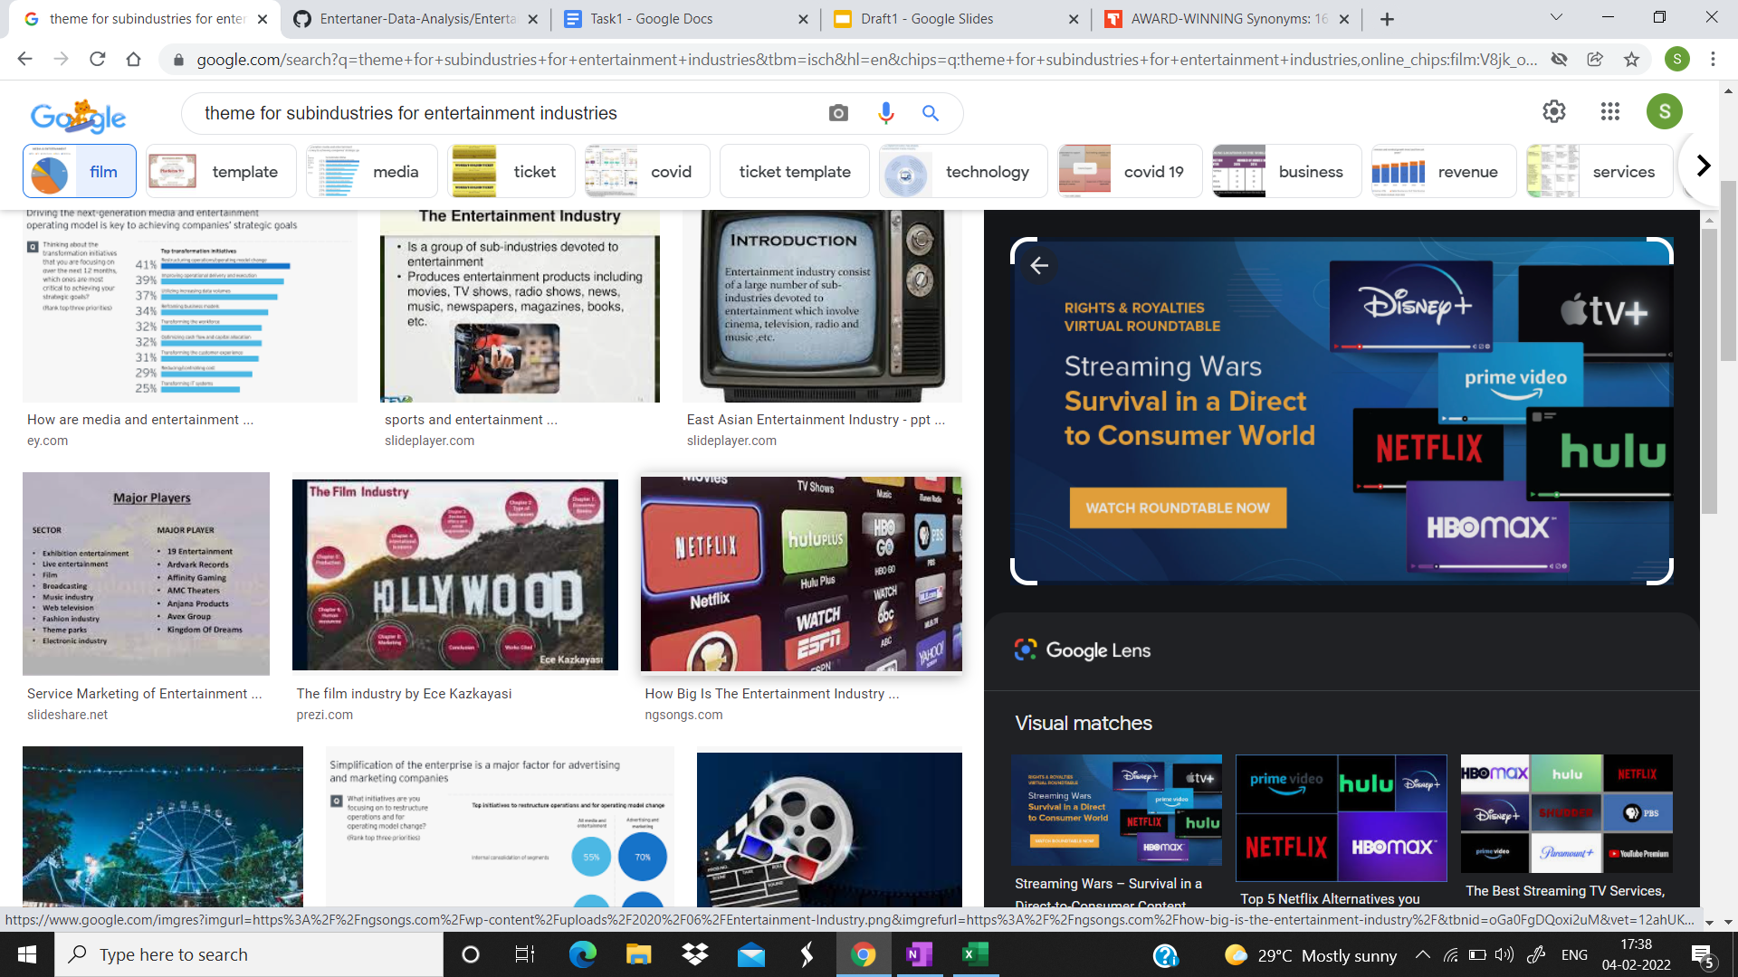
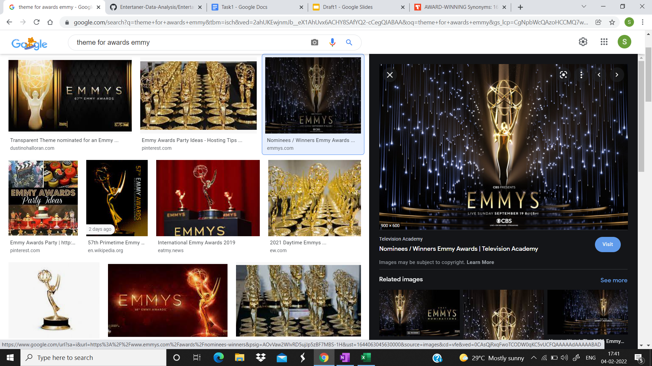
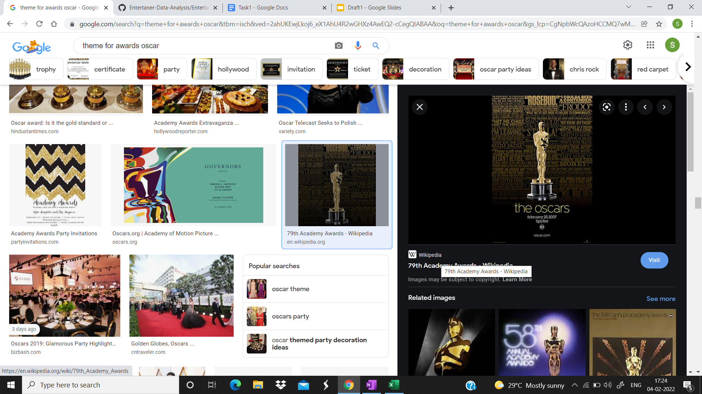

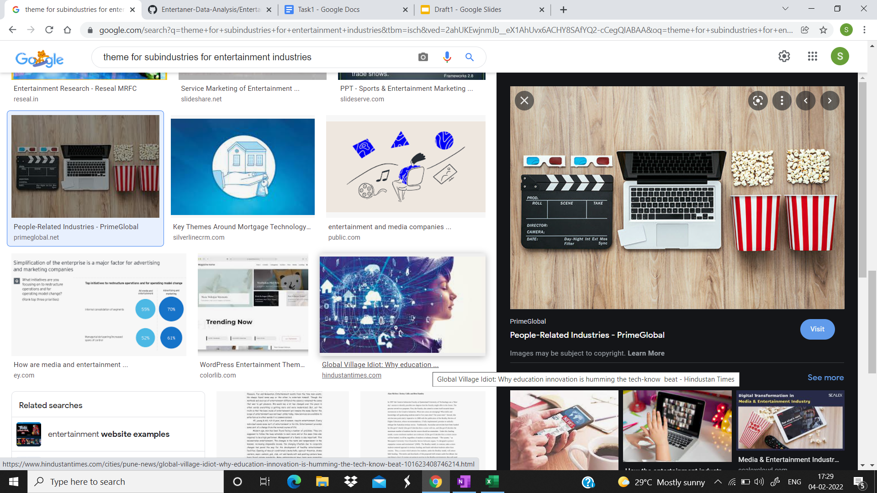
Theme
Contribution of various sub-industries to the growth of mass media entertainment.

Slide 12
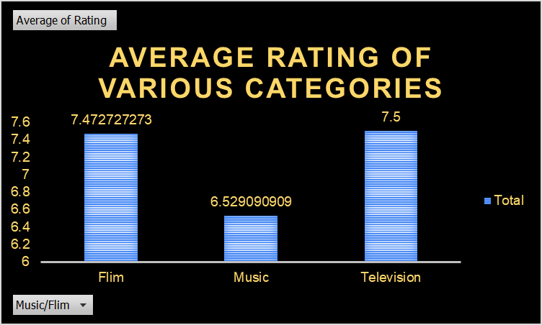
Visuals
Average Rating of various categories of Entertainment
Average rating for people watching film and television is almost same.

Slide 13
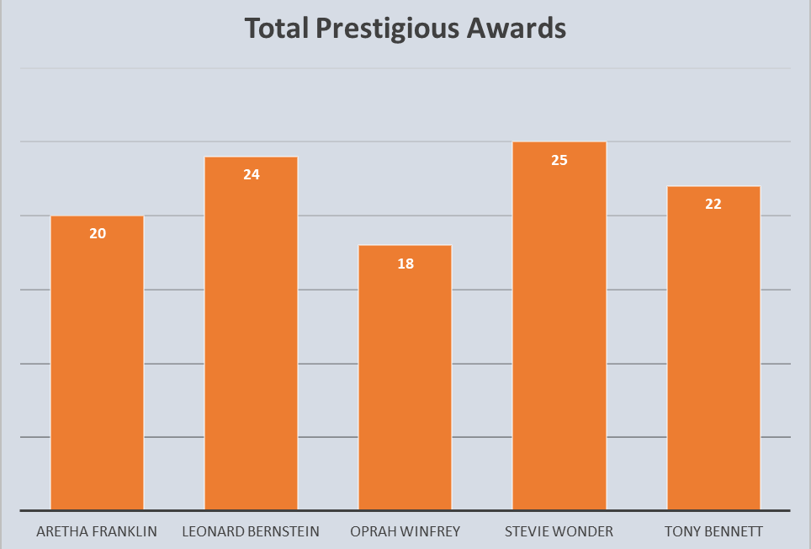
Visuals
Top 5 people who won maximum awards.
These are the total number of Grammy, Oscar and Emmy awards won by entertainers.
Stevie Wonder won maximum awards followed by Leonard Bernstein.

Slide 14
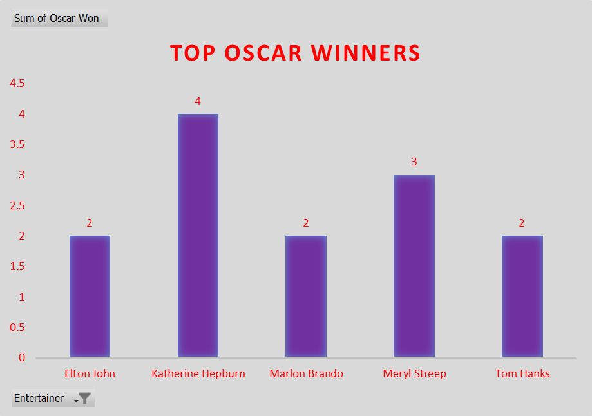
Visuals
Top 5 Entertainers who won maximum Oscar awards.
Katherine Hepburn won maximum Oscars followed by Meryl Streep.

Slide 15
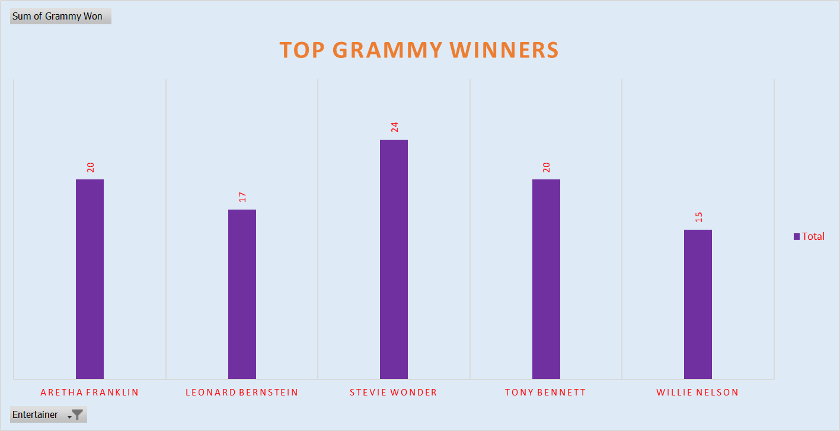
Visuals
Top 5 entertainers who won maximum Grammy Awards
Stevie Wonder won maximum Grammy Awards followed by Aretha Franklin and Tony Bennett

Slide 16
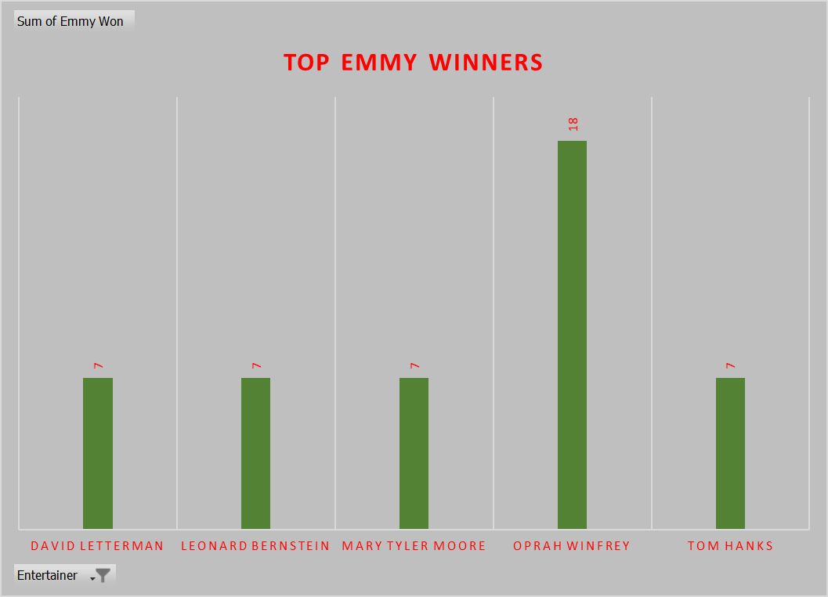
Visuals
Top 5 Entertainers who won maximum Emmy Awards
Oprah Winfrey won maximum Emmy Awards followed by Mary Tyler Moore.

Slide 17
Thank You

Slide 18
Presentation By:
Amirta V
Sudhanshu Dandriyal
Sneha Arun
Vaibhav Joshi

